Slide 1

RxClaim Delivery Review Jan ‘18

Slide 2
Agenda
Agenda
Executive Summary
Current Head Count & Demand
Capacity Utilization & Forecast
Attrition Trend
Delivery Highlights & Updates
Initiatives – BI/CI
Our People First
2018 Focus Areas

Slide 3
Executive Summary - 2017
Insource IP related work & Growth
Successful Transition of ~ 100 vendor resources from IBM, CTS & GalaxE primarily in RxClaim Core Product Development - Total Team size of 200+
8.3.06, 8.3.07 & 8.3.08 deployed successfully with ~ 50% accountability of development - 8.4.0 are in progress – 300 + SRs worth >60 K hrs of Development work
5 MODS releases for LORx with more than 600 SR’s & more than 20 K hrs of work
~ 40 Custom Capital Projects worth more than 20 K hrs
Custom Deli (Eligibility & Work Order) - 26 projects, 130 Work Orders with more than 20 K hrs
Support team closed more than 3000 service now tickets & 130 problem tickets and also contributed around 1K hrs of Dev efforts towards PLM upgrade projects for Vitria and the RXMACRO application to enhance stability & security
Delivery Execution
Cost
Achieved a business impact of $5.18 Mn vs. a target of $ 4.27 Mn (exceeded by 20%)
Business Impact
Automation of Manual Claim Entry Solution presented to Business stakeholders
Solutions provided for 8 ideas to improve process efficiency in collaboration with BPO team
Business Process improvement through IT/BPO collaboration
AS400 Competency
Designed & created a framework for trainings & onboarding . Concluded 2 batches of TDP academy
Certification program designed for L1 & L2 assessment
Vital Sign – 80%; 300+ Bravos for 120+ team members from 60+ US leaders (IT / Business)
Delivery Updates

Slide 4
Current Headcount and Demand Forecast / Fulfillment
Current Headcount and Demand Fulfilment
Leader | Lead / Manager | Team | / Approved Headcount | On Board | Jan | Feb | Mar | Apr | Open
Bob Kudis | Tarek | Base Deli (Medicaid + Fast Track) + GUI | 19 | 18 | 1 | 0 | 0 | 0 | 0
Bob Kudis | Raj Velnati | MODS + Retrofit + Kaiser | 26 | 26 | 0 | 0 | 0 | 0 | 0
Bob Kudis | Cindy | CBS + Payments | 23 | 23 | 0 | 0 | 0 | 0 | 0
Bob Kudis | Penny | Govt Program | 25 | 25 | 0 | 0 | 0 | 0 | 0
Bob Kudis | Krishna K | RxClaim SSMO | 31 | 29 | 0 | 0 | 1 | 0 | 1
Bob Kudis | Vishal Prateek | EDI SSMO | 6 | 6 | 0 | 0 | 0 | 0 | 0 | 130
Sameer D | Keith Chan | Plan | 28 | 28 | 0 | 0 | 0 | 0 | 0
Sameer D | Navin | External Interfaces | 7 | 7 | 0 | 0 | 0 | 0 | 0
Sameer D | Rob Planica | EDMI | 2 | 2 | 0 | 0 | 0 | 0 | 0
Sameer D | Kalyana | Eligibility & Work Orders + RxCCR | 16 | 16 | 0 | 0 | 0 | 0 | 0 | 53
Dave Cattran | Scott M | Modernization | 6 | 6 | 0 | 0 | 0 | 0 | 0
Dave Cattran |  | Eligibility Modernization | 5 | 5 | 0 | 0 | 0 | 0 | 0
Dave Cattran | Erika | Rx Support Tech Transformation/Optumizers | 2 | 2 | 0 | 0 | 0 | 0 | 0 | 13
Nitesh |  | RxWeb/RxBuilder SSMO | 12 | 12 | 0 | 0 | 0 | 0 | 0
Nitesh |  | Formulary | 6 | 1 | 0 | 0 | 0 | 0 | 5 | 18
Dan Zerafa |  | RxClaim | 1 | 1 | 0 | 0 | 0 | 0 | 0
Dan Zerafa |  | 2018 Additional Demand | 7 | 0 | 1 | 0 | 2 | 2 | 2
Jim Park | Jim High | Cigna | 1 | 1 | 0 | 0 | 0 | 0 | 0
Christina | Dawn | RxParallel | 3 | 3 | 0 | 0 | 0 | 0 | 0 | 3
Kim Jackson |  | Release / Operational Management | 4 | 2 | 0 | 1 | 0 | 0 | 1 | 4
Bill Meyer | Amie | Ab-Initio | 6 | 6 | 0 | 0 | 0 | 0 | 0 | 6
 |  | Total | 236 | 220 | 2 | 1 | 3 | 2 | 9
Resourcing Updates
Hiring for 2018 Additional demand for iSeries is in progress - 6 folks aligned to RxClaim Core Support
Requisitions for 6 Formulary positions initiated & in approval process

Slide 5
Utilization - Current and Forecast
Utilization – Q4 2017
Q4 2017:
Reasons for High TAFW :
2 days of holiday in Oct, 2017.
Planned leaves due to Diwali Festival
Modernization – Some KT hours due to Resource Movement
Jan’18:
High (15-20%) TAFW anticipated due to New Year holiday and festival vacation plans.
High Admin hours anticipated due to Agile trainings planned for the teams.
No KT hours expected
Forecasted Utilization - Jan

Slide 6
Attrition Trend for 2017
Highlights
Attrition is low as compare to broader organization & industry Top performers' retention is high – 97%
Next Steps
Notes:
MODS 1, Govt Programs 2, CBS 1, EDI 2, RxParallel 1, Deli 1, RxWeb SSMO 1, RxClaim SSMO 1

Slide 7
delivery updates

Slide 8
Engagement Updates (BASE Releases)
# Releases
3 | 3 | 3 | 1 | 1 | 3 | 5
Key Achievements / Functionalities Delivered
EGWP Phase 1: Introduced new set of EGWP rules to support complex benefits for members at POS in addition to enhancement to the pricing logic for Medicare plans
Enhancements to NCPDP load programs to support additional data related to Pharmacy for government program compliance
Enhanced Transitional Benefits logic to optionally pay drugs only up to a certain quantity as defined by the plan by introducing Daily Dose restrictions
CalPERS Projects: To execute payments and remittance advices to members and pharmacies in support of the implementation of CalPERS. There are custom files and reports that require development using file layouts supplied by both entities.
Cigna Projects: Updated the PA reporting/loading processes to extract/load the PAs multiple times during a day as needed by the Clients. Allow clients to load/extract additional data to the Pharmacy Cost Pricing Schedule using which the Plan finder files are generated.
Other major Projects: Texas ERS Surcharge Reporting Project: To enhance RxClaim to calculate surcharge values based on client rules, record and report the same for payment and billing.

Slide 9
BASE Releases Metrics
Note : Increase in the Development defect density for Plan 8.3.07 is due to the increased Scope, Complexity and Frequent FRD/GUI changes. Approx. 42% of QA defects were due to missing requirement in FRD.
In order to improve the delivery quality, we have adapted the SDR process, strengthen the peer/lead reviews and work through the teams using internal defect review forum.

Slide 10
Engagement Updates (Monthly Releases)
# Releases
9 | 12 | 12 | 3 | 12
Key Achievements / Functionalities Delivered
Implemented one of the big 3 clients “CalPERS” into RxClaim
Implemented new enhancements for CA, AZ, IL state Medicaid and mitigated the potential penalties of $120k
Performance tuning of CalPERS claim extract to run from 8 days to 5 hours is a big improvement
MAC pricing automated generation for Washington client completed and implemented successfully
Migrated OHIO and OPTIMA clients from SXCA6 production box to BK1 prod system. File generated and sent to client on 1/2 without any issues
POLARIS program - modifications of Eligibility and Claim History files and deployed in BK2 on 12/1
TEXAS ERS - Moved the membership from Book2 to Book1 and also involved for complex WTX map, ID card extract and Claim History file related changes.
WTX - Implemented new maps for Hartford, Morgan Stanley and Federal reserve bank with aggressive timelines
NICE - Project to add new accounts to the existing eligibility load on Book1

Slide 11
Monthly Releases Metrics - 2017
Note : Increase in the defect density for Work Order team was in the month of July where team finished the transition and took over independently. There were also change in requirements for which team was not completely equipped.
In order to improve the delivery quality, we did the RCA of defects and improved the delivery using specific actions like regression testing , etc.

Slide 12
Engagement Updates (Sprint Releases)
Key Achievements / Functionalities Delivered
State Medicaid team is the first team in RxClaim to adapt Agile methodology development. A journey of successful implementation of 4 sprints covering 253 user points without any business defects in production proved the sustaining adaptability of the team
As part of Product Increment1 (2017-PI01) , deployed following with no issues
Virginia – 5 corresponding SRs deployed to Production
Horizon New Jersey – 3 corresponding SRs deployed to Production
Oregon - 2 corresponding SRs deployed
Successfully submitted Utah encounter Test file with state. Acceptance ratio of claim is ~98.7%.
Virginia Encounter implemented successfully in a short time and received a positive acknowledgment from state.
Optumizers successfully completed of 4 sprints without any issues.

Slide 13
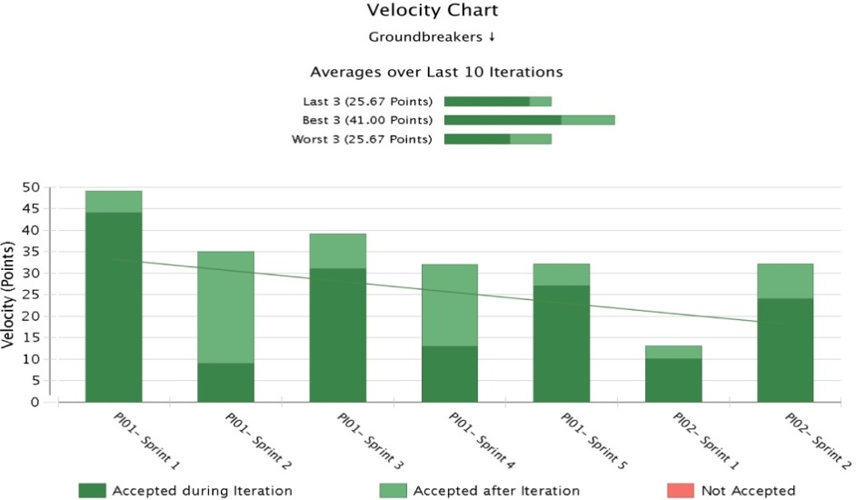
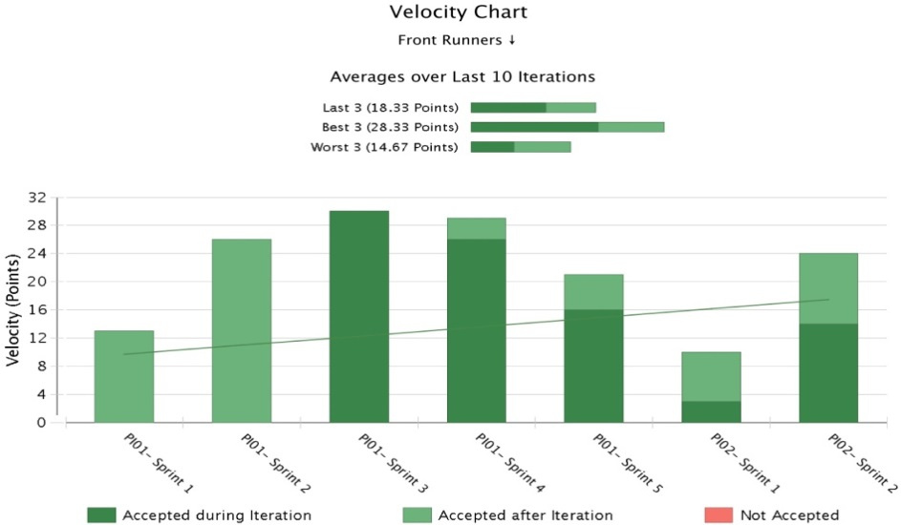
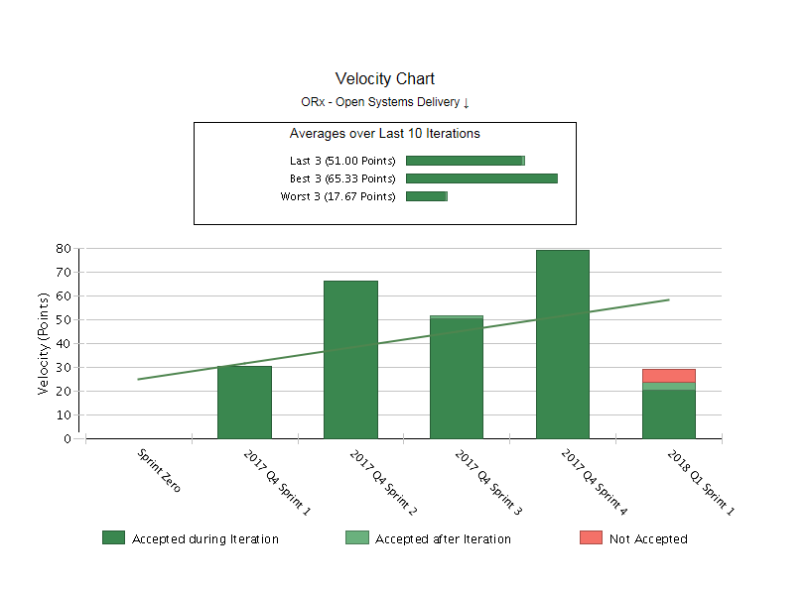
Velocity Charts for Agile Transformed Teams
Front Runners delivered 129 Story Points in 6 sprints
Groundbreakers delivered 200 Story Points in 6 sprints. 49 Story Points delivered in the very first sprint.
Optumizers delivered 226 Story Points in 4 sprints. Maximum of 79 Story Points delivered in sprint 4.

Slide 14
Engagement Updates - CBS
Key Achievements / Functionalities Delivered
CBS COR2 Project - Migrating Internal OptumRx Clients from current L-Orx system to CBS billing system and supporting the current billing and reporting requirements
Proc Claim Daily Performance Improvement - In order to improve the performance of Proc Claim daily job, it is required to limit the scan of Claim Header table to last 60 days only.
Archiving Claims data - Performance Improvement by the table partitioned stores claim data.
WebSphere upgrade Phase 1 completed and handed over to US team for UAT. Phase 2 development is in progress.
All 9 priorities of Data stage upgrade is delivered to US team for UAT. OGS is supporting the higher environment testing along with the US team.
AR03, Automation of e-mail notifications and Job monitoring projects are kicked off and dev in progress currently.
Working on the estimates of 19 2018 Projects.

Slide 15
Support Project Metrics
Availability: Improved due to automated self healing monitors and permanent fixes implemented for all potential P1/P2 issues.
SLA: SLA’s improved due to streamlined processes and best practices.
Incident/Problem influx: Reduced as most of recurring issues are addressed proactively with regular trending review.
Major PLM Upgrades / Accomplishments:
RxClaim CFT (Cross File Transfer) upgrade
RxClaim FTP to CFT Conversion (NAS Migration)
RxClaim Storage Cleanup Automation
PDE Process automation
RxWeb Web-services PLM upgrade
RxWeb IE upgrade
RxMacro Upgrade to 4 Unix servers.
VITRIA Server migration & tomcat upgrade

Slide 16
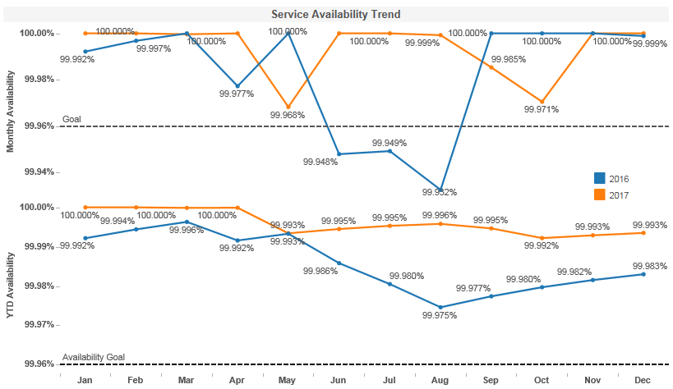
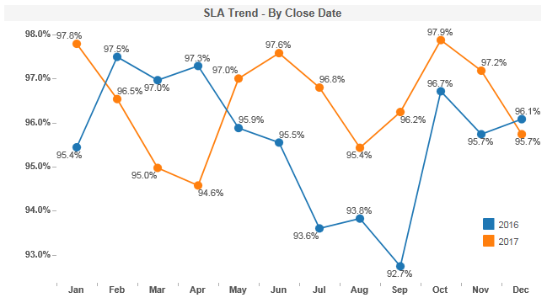
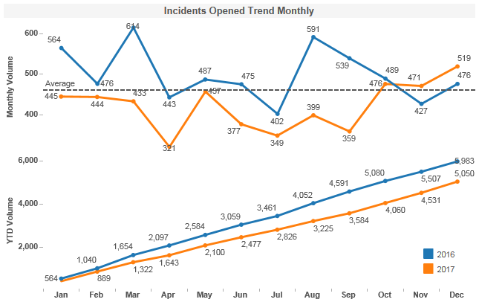
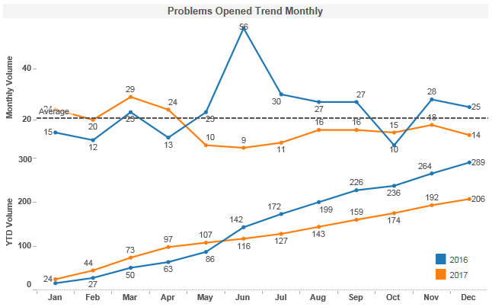
RxClaim Application Metrics (BK1 / BK2)
Overall availability increased as proactive monitors were implemented for potential causes.
SLA were improved as guidelines were in place and with regular tracking
Overall influx reduced as most of the recurring issues were permanently addressed.
PT influx reduced as Leaked defects excluded and recurring issues were already addressed.

Slide 17
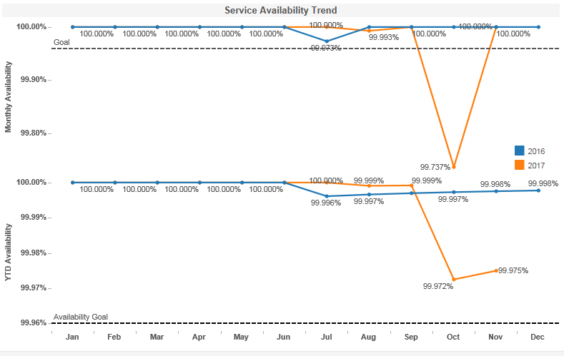
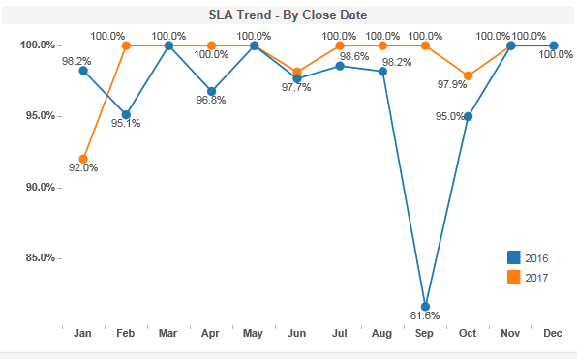
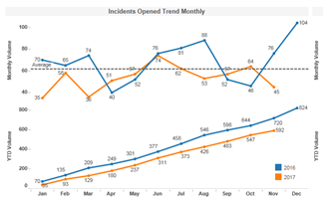
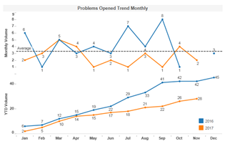
RxWeb Application Metrics
Availability impacted majorly due to Navigator change where they removed IP for RxWeb services.
SLA were improved as guidelines were in place and with regular tracking
Overall influx reduced as most of recurring issues were addressed proactively.
Problem influx reduced as recurring issues were already addressed.

Slide 18
Initiatives

Slide 19

Rx Claim – Dev Continuous Improvement - 2017
Achieved
$ 5.18 MM
Target : $4.27 MM
27 Ideas Implemented
SSMO - $4.7 MM
Govt Pgm– 0.27 MM
DELI – 0.1 MM
Retrofit - $0.8 MM
24% Lean Trained
7% Lean Certified
Challenge
Solution
Impact
Standard automated process established to Monitor all user libraries in Production, Notify Users and purge unwanted data
Manual effort saved 100 hours / month
Storage saved 12 TB / month
Business Impact of $3 MM
Manual monitoring of DASD utilization, Data deletion operations, Notifying users
Space Issue in IFS Folder
Lack of Purge Process
Developed a purge process which can be used to purge files at IFS location using File Naming Convention and Retention.
Reusable Purge Process
Business Impact of $0.4 7MM
Manual Process for generating reports through SAS Jobs for M&R, Core and External Customers
Created a utility to increase the performance and configured it for the 4 critical jobs
Automated Reports for Business to analyze
Business Impact of $0.36 MM
Spool files occupying space with no aging process with potential impact to system performance
Automated process to delete Spool Files in Daily production basis aging
Avoid impact on System Performance
Business Impact of $0.28 MM
Dual simultaneous development leading to defects and production issues
Creates a job which select those objects in CLMV25OBJ which has Todays create date and check if these objects are currently checked out in Base release. If yes, then auto mail to developers
Reusable Dual Development Comparison Tool
Business Impact of $0.24 MM
Manual process for creating the 835 File with no purge process and tracking mechanism of issues
Created a Auto purge process for the files for empty members in defined libraries at defined intervals with an input file to store the details of the files, libraries , record threshold for purge
Avoid impact on System Performance
Business Impact of $0.13 MM

Slide 20



CI 2018 Road Map – Rx Claim Dev
Execution, Simplification & Cost Management
Reduce P1 & P2 Incidents
Improve Pre / Prod Defect Density
Innovation / Cost Saving
$ 5.5 MM Business Impact
Implement Ideation Council towards Innovation
2018
Focus Areas
Culture & People Engagement
Improve Bright Idea penetration and Implementation
Improve Lean and GB certification
Business Integration and Alignment
Rx Manual Claim Automation
BOM Opportunities – Client onboarding TAT etc.
Confidential property of Optum. Do not distribute or reproduce without express permission from Optum.

Slide 21
Our People First

Slide 22
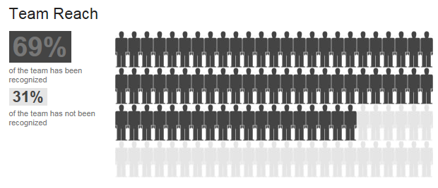
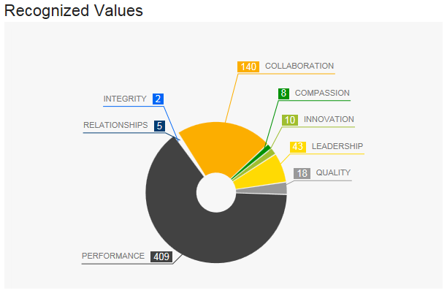
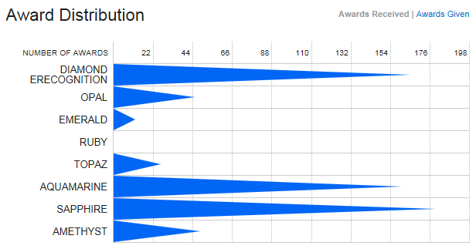
Bravo
298 Recognitions from onshore stakeholders
185 in Q4 (75% of total Bravos in Q4)

Slide 23
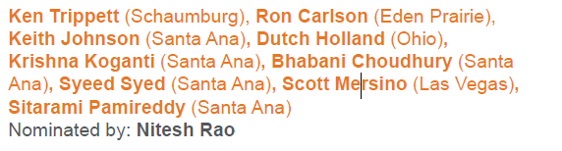
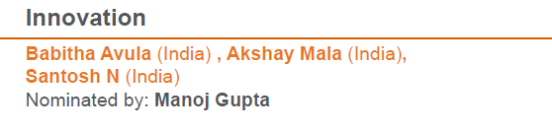
IT Rock Stars
Team Work

Slide 24
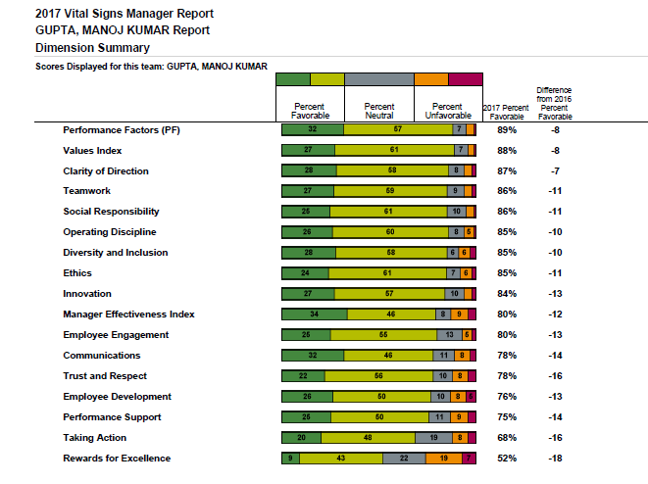
Vital Sign 2017
Scores have gone down as compare to last year:
Lot of new team members (neutral score have gone up)
Org changes in the middle of the year e.g. SSMO

Slide 25
2018 Focus Areas

Slide 26
Focus Areas – Strategic / Operational
Strategic
Operational
Improve development quality; shift from Quality Assurance to Engineering & Test Automation – Defect Prevention vs. detection.
Adaption of Agile delivery methodology along with CI/CD / DevOps implementation
Implementation of Hybrid CoE (End to End Delivery) framework
Improve Penetration in Formulary (Vendor Transition)
Consolidation of eligibility – unique member id across multiple instances of RxClaim
Optimize RxClaim sources achieving a 10% productivity target (cpu, disk, pgms).
Standardize model, instrumentation and support practices across all platforms – Production Support for LCTR instances
IT-BPO Collaboration (specific pointers e.g. BOM) to improve / automate client onboarding process
Design and Implement a Global rotation policy for developing SME’s on Core applications

Slide 27
Appendix

Slide 28
Monthly Releases Metrics

Slide 29
Monthly Releases Metrics (Cont…)

Slide 30
State Medicaid
Team 1: Groundbreakers
 | Start | End | Planned Stories | Accepted Stories | Delivered Story Points
PI01-Sprint 1 | 9-Oct-17 | 25-Oct-17 | 10 | 10 | 49
PI01-Sprint 2 | 25-Oct-17 | 8-Nov-17 | 11 | 11 | 35
PI01-Sprint 3 | 8-Nov-17 | 21-Nov-17 | 9 | 9 | 39
PI01-Sprint 4 | 22-Nov-17 | 5-Dec-17 | 10 | 10 | 32
PI01-Sprint 5 | 6-Dec-17 | 19-Dec-17 | 9 | 9 | 32
PI02-Sprint 1 | 20-Dec-17 | 2-Jan-18 | 5 | 5 | 13
PI02-Sprint 2 | 3-Jan-18 | 16-Jan-18 | 9 | In Progress | In Progress
 |  | Total | 63 | 54 | 200
Team 2: Front Runners
 | Start | End | Planned Stories | Accepted Stories | Delivered Story Points
PI01-Sprint 1 | 11-Oct-17 | 25-Oct-17 | 2 | 2 | 13
PI01-Sprint 2 | 25-Oct-17 | 8-Nov-17 | 7 | 7 | 26
PI01-Sprint 3 | 8-Nov-17 | 21-Nov-17 | 8 | 8 | 30
PI01-Sprint 4 | 22-Nov-17 | 5-Dec-17 | 8 | 8 | 29
PI01-Sprint 5 | 6-Dec-17 | 19-Dec-17 | 7 | 7 | 21
PI02-Sprint 1 | 20-Dec-17 | 2-Jan-18 | 3 | 3 | 10
PI02-Sprint 2 | 3-Jan-18 | 16-Jan-18 | 8 | In Progress | In Progress
 |  | Total | 43 | 35 | 129
Major Functional Impact
Till date, a total of 89 user stories of worth 329 Story points delivered successfully without any issues on combination of both the teams
Currently, 2018-PI02 Sprint 2 is in progress and to complete on 16-Jan
As part of Product Increment1 (2017-PI01) , deployed following with no issues
VA – 5 corresponding SRs deployed to Production
HNJ – 3 corresponding SRs deployed to Production
OR - 2 corresponding SRs deployed
Accomplishments | Risks /Challenges/ Issues
Successfully submitted Utah encounter Test file with state. Acceptance ratio of claim is ~98.7%. Virginia Encounter implemented successfully in a short time and received a positive acknowledgment from state. Successful completion of 6 sprints without any issues in production. Smooth journey over Agile methodology being the first team from RxClaim. | Pair Programming: Dependency ,Merging and sometimes Rework in case of multiple members working on same program or SR Collaboration : maintaining a separate copy for each and merging the changes once done and then continuing Unit Testing Support: One member develops code and other helps in supporting activities such as Test data preparation and executing Unit Test cases.

Slide 31
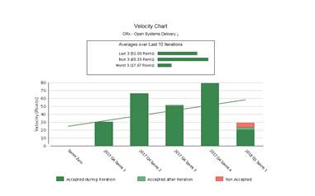
RxSupport Redesigning (Optumizers)
Sprint Details
SP delivered in last 5 Sprints
Team Optumizers
 | Start | End | Planned Stories | Accepted Stories | Delivered Story Points
Sprint 1 | 6-Nov-17 | 18-Nov-17 | 9 | 9 | 30
Sprint 2 | 20-Nov-17 | 2-Dec-17 | 15 | 15 | 66
Sprint 3 | 4-Dec-17 | 16-Dec-17 | 13 | 13 | 51
Sprint 4 | 18-Dec-17 | 29-Dec-17 | 14 | 14 | 79
Sprint 5 | 02-Jan-18 | 13-Jan-18 | 9 | 8 | 28
 |  | Total | 60 | 59 | 254
Major Functional Impact
Total of 5 Sprints delivered with 60 user stories. 254 Story points completed successfully without any issues on combination of both the teams
Sprint 6 is in progress .
In Sprint 1 team was working on virtual desktop , but later on with team effort and knowledge we were able to move to local network which in turn result in delivery of more user stories and story points
Accomplishments | Risks /Challenges/ Issues
Successful completion of 5 sprints without any issues in UAT Recognition from client for delivering using Agile and faster response time | Gaps between onshore and offshore regarding understanding of Agile methodology

